Slide 1
Getting start with the Framework Tutorial @ IE2025
Dr.-Ing. Christian Beyer | 24.06.2025
christian.beyer@ovgu.de
Notes:
Multi-Task Learning → partly true, →do not share structure unless ensemble → different training data but same task
Recommenders rely user-user or item-item similarities. -> ignored
Recommenders often aggregate data across entities. ->not yet.
Recommenders seek cross-entity generalization (e.g., new users/items).
Entity-centric learning focuses on intra-entity generalization, avoiding global patterns.

Slide 2
Content
Setup
Running experiments

Slide 3
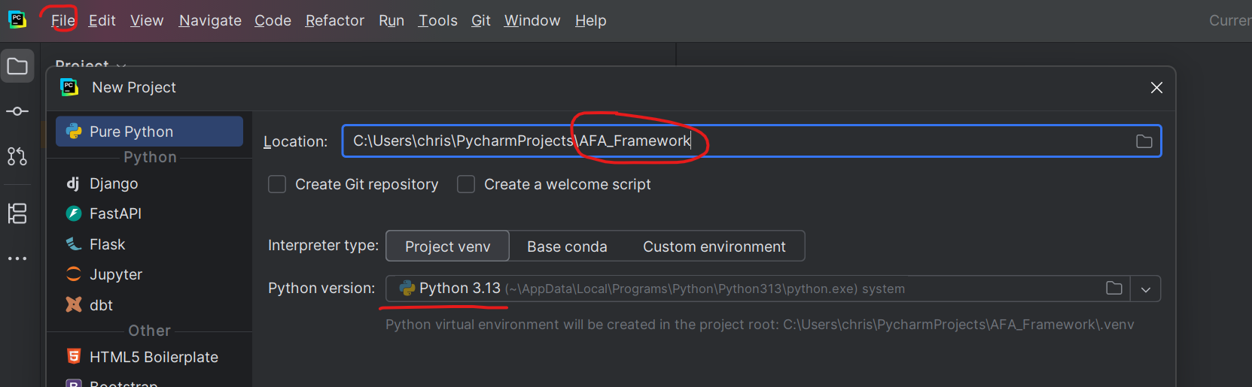
Setup
Use preferred python IDE e.g. Pycharm
Get framework code from github or cloud
Create a new project using Python 3.13
Notes:
Maybe explain active learning briefly

Slide 4
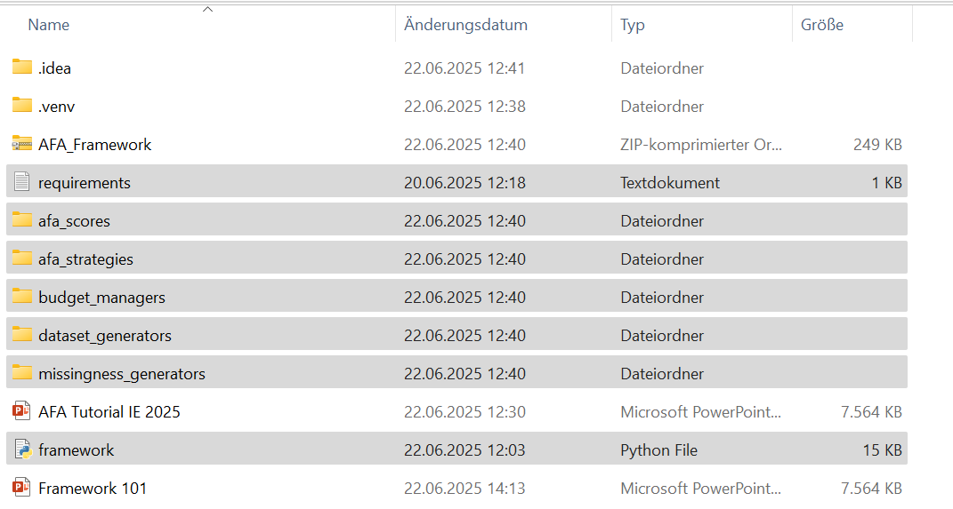
Setup
add the selected files from the zip file into your projects folder
Notes:
Maybe explain active learning briefly

Slide 5
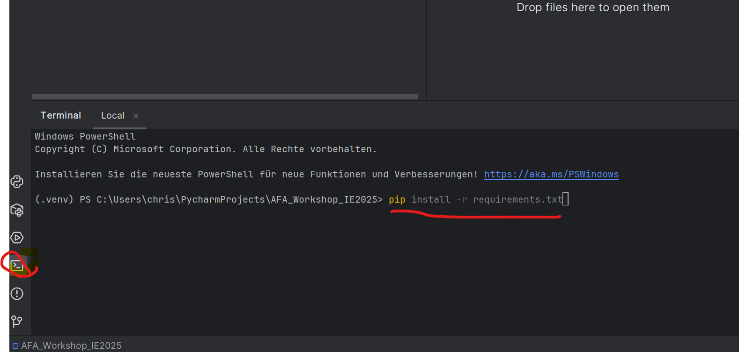
Setup
Go to console and run: pip install -r requirements.txt
Notes:
Maybe explain active learning briefly

Slide 6
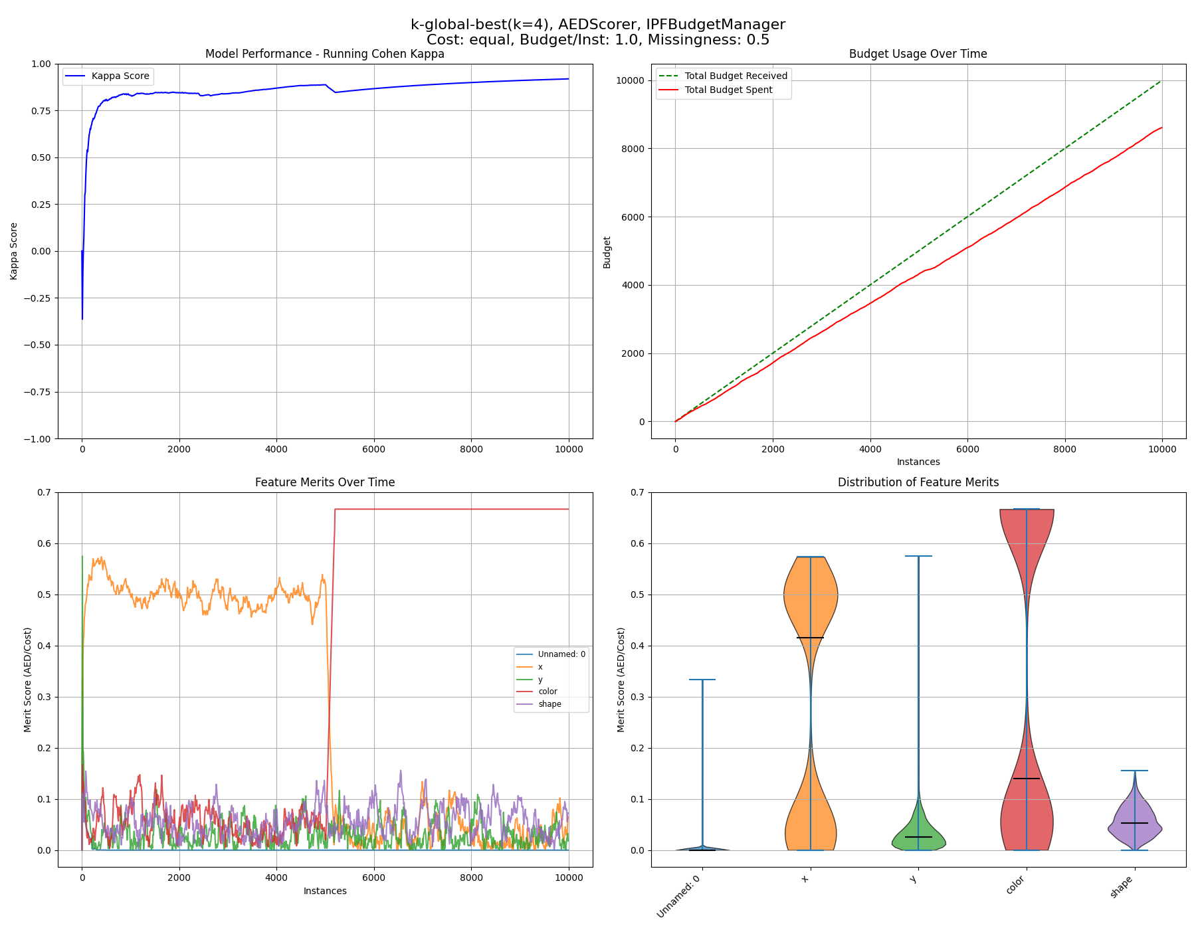
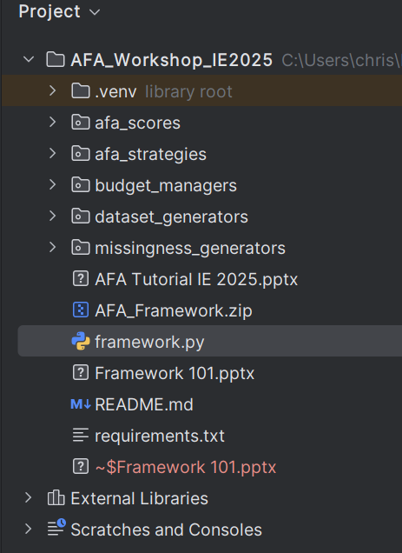
Setup
Open the framework.py and run it which should give you these plots
Notes:
Maybe explain active learning briefly

Slide 7
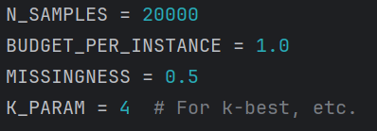
Running experiments – Base Settings
Open the framework.py and scroll down to the main function
Here you can set the parameters of an experiment
Maximum number of instances per stream
B_gain
Percentage of missing features (MCAR)
k of AFA strategy e.g.k-best
Notes:
Maybe explain active learning briefly

Slide 8
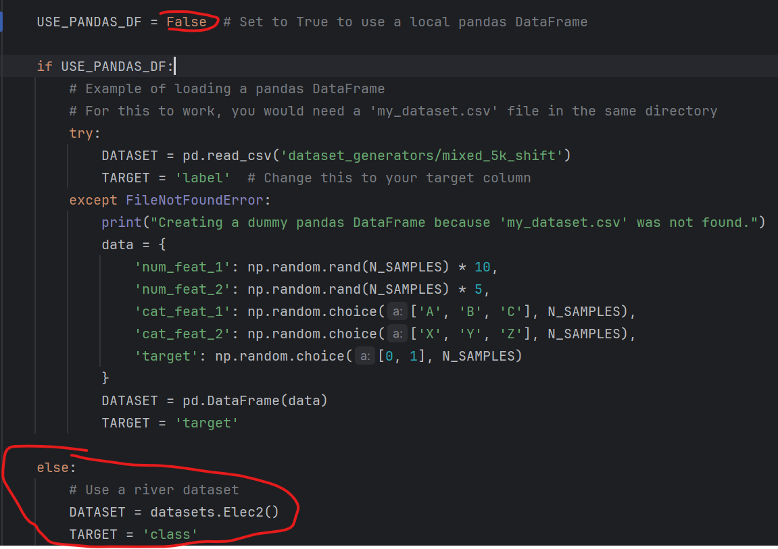
Running experiments – Datasets
If you want to try different standard datasets from riverml set USE_PANDAS_DF to False and change the TARGET variable according to your dataset (e.g. Elec2)
Otherwise leave it on True and change the path to your CSV and adjust the TARGET
Notes:
Maybe explain active learning briefly

Slide 9
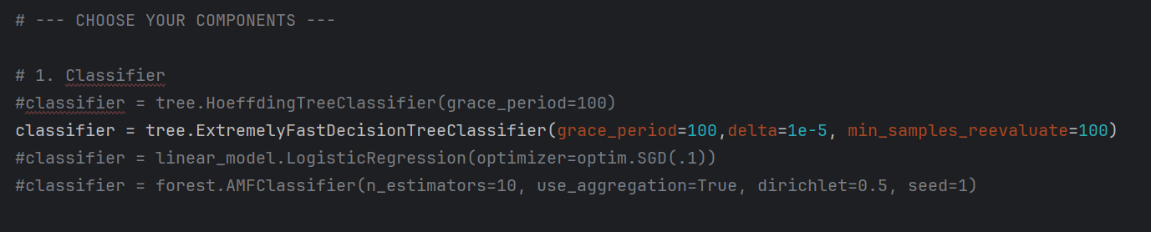
Running experiments – Classifiers
Try different classifiers you can also add more from riverml (tree, forest, linear_model, ensemble, naïve_bayes, neighbours…)
Remove # of classifier of choice and add # to rest unless already there e.g. use the ExtremelyFastDecisionTreeClassifier
Notes:
Maybe explain active learning briefly

Slide 10
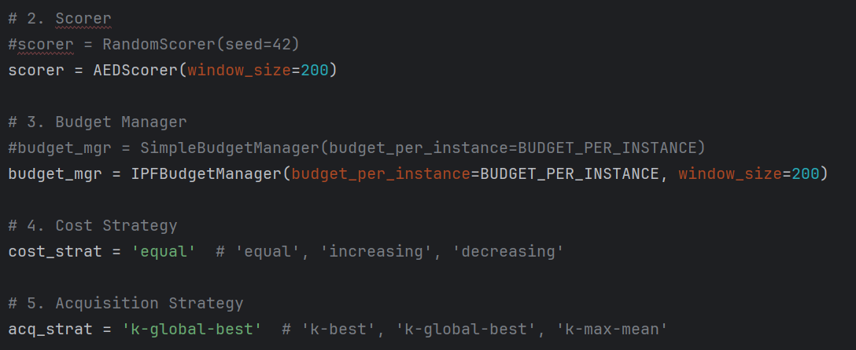
Running experiments – Scorer, Strategy and Feature Costs
Select feature scoring mechanism
Notes:
Maybe explain active learning briefly

Slide 11
Running experiments – Scorer, Strategy and Feature Costs
IPF buys based on quality gain (recommended). Simple version always buys when selected features fit into current available budget.
Notes:
Maybe explain active learning briefly

Slide 12
Running experiments – Scorer, Strategy and Feature Costs
If we have n features. Equal = all cost the same. Increasing = first costs 1, last cost n. Decreasing = first cost n , last costs 1.
Notes:
Maybe explain active learning briefly

Slide 13
Running experiments – Scorer, Strategy and Feature Costs
k-best: buy k of missing features with highest merit k-global-best: rank all features according to merit buy up to k missing features if they are among the top k globally k-max-mean: add missing feature with highest merit if it improves instance quality (up to k)
Notes:
Maybe explain active learning briefly

Slide 14
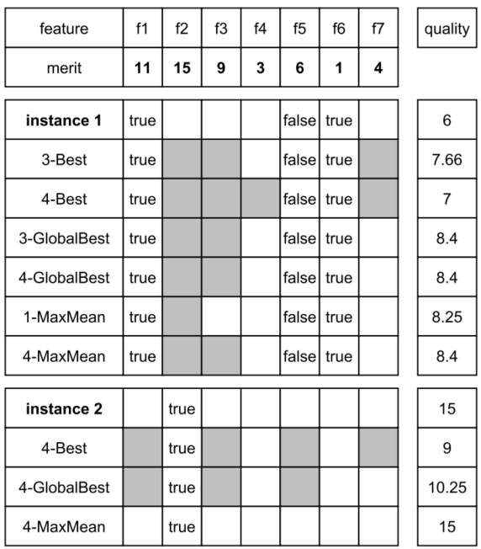
Running experiments – Strategy Example
Notes:
Maybe explain active learning briefly

Slide 15
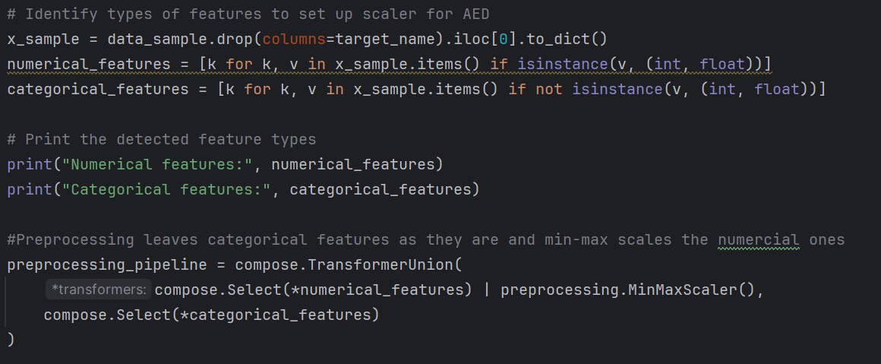
Running experiments – Normalization in run() function
Framework tries to identify numerical and categorical features automatically and applies Min-Max-Scaling on numberical features while leaving categorical features as they are (run() function)
Notes:
Maybe explain active learning briefly

Slide 16
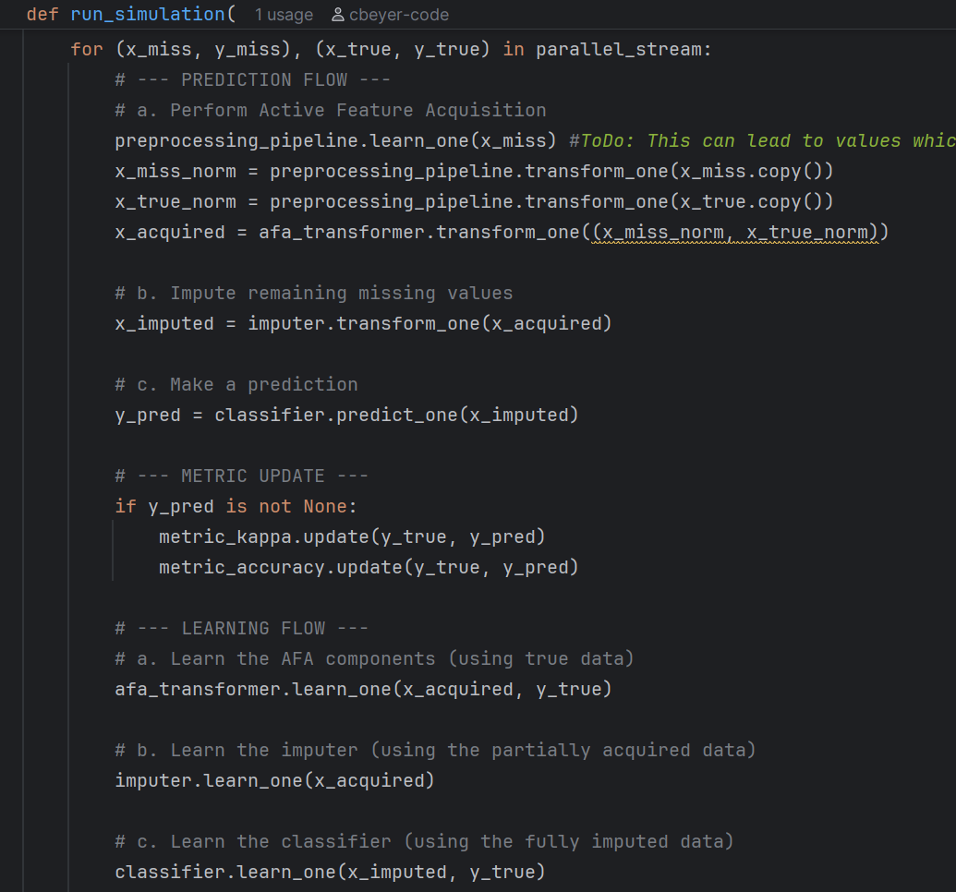
Running experiments – run() function Overview
Updates Min-Max-Scaler based on instance that has missing features
Notes:
Maybe explain active learning briefly

Slide 17
Running experiments – run() function Overview
Normalizes instance with missing features and instance with all features available
Notes:
Maybe explain active learning briefly

Slide 18
Running experiments – run() function Overview
Applies AFA strategies and returns instance with acquired features
Notes:
Maybe explain active learning briefly

Slide 19
Running experiments – run() function Overview
Updates budgeting and feature merits
Notes:
Maybe explain active learning briefly

Slide 20
Running experiments – Instances in RiverML
Most machine learning libraries use arrays to represent instances
RiverML uses dictionaries!
Age | Height | Weight
33 | 176 | 72
usually
RiverML
[33,176,72]
{‘Age’:33, ‘Height’:176,’Weight’:72}
Notes:
Maybe explain active learning briefly

